Slide 1

Transition Guide
Supporting students to manage the transition to secondary school
Name:

Slide 2
Find the subjects below in the Word search – they are vertical, horizontal and diagonal!
M | A | F | S | E | H | M | G | E | O | H | I | M | J | E | E | A
F | M | A | M | W | S | L | U | S | M | I | S | E | T | T | I | S
R | U | D | A | N | C | E | Z | S | A | C | P | N | U | H | A | I
A | F | G | T | R | D | P | W | R | I | I | A | G | T | I | N | U
H | S | R | H | P | G | R | T | E | N | C | I | T | O | C | A | O
J | T | A | S | L | U | B | N | Y | R | A | N | E | R | S | S | L
T | U | B | J | E | I | C | Q | L | E | R | M | X | T | A | S | S
E | E | A | U | H | E | M | U | A | H | S | U | D | I | N | E | P
N | F | X | L | G | E | O | G | R | A | P | H | Y | M | D | M | A
G | I | M | T | V | M | A | I | T | Y | E | O | A | E | M | B | N
L | O | A | I | I | O | T | O | H | R | T | T | S | C | O | L | I
I | P | T | E | E | L | G | R | D | U | O | E | R | A | R | Y | S
S | P | U | F | O | S | E | E | K | R | M | P | T | T | A | E | H
H | I | S | T | O | R | Y | S | C | S | A | S | M | E | L | R | A
E | N | J | V | E | P | I | F | J | N | O | M | U | R | S | B | K
J | K | C | A | T | E | R | I | N | G | C | N | A | R | P | U | M
Y | Z | X | T | L | S | V | Z | C | O | M | P | U | T | I | N | G
Maths
English
Science
Geography
History
Art
Music
PE
Drama
Dance
Textiles
Catering
Computing
Ethics and Morals
Spanish
Assembly
Tutor Time

Slide 3
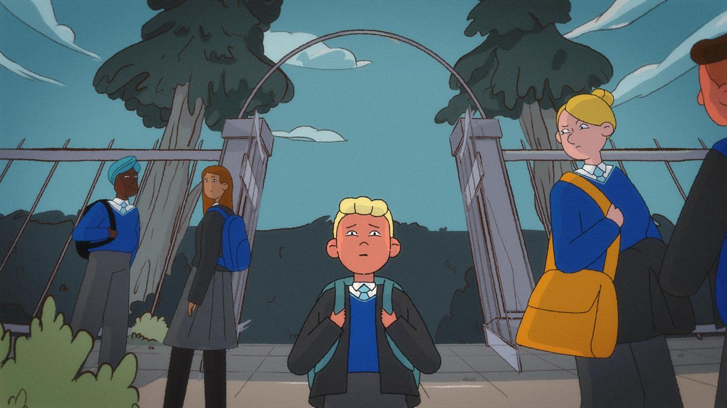
Moving Up!
What challenges do the characters face? How do they solve them?

Slide 4
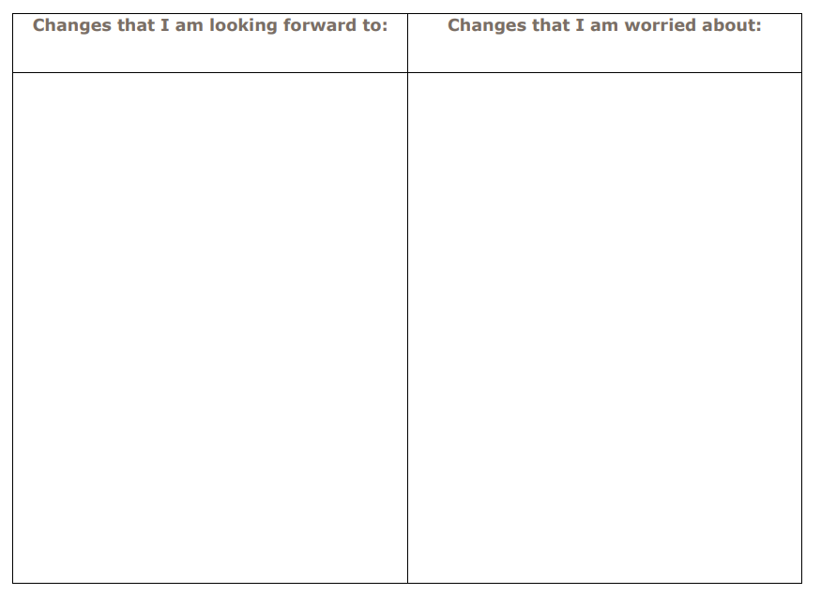
The transition to secondary school
Activity One: Embracing Change
Moving to a new school can be both exciting and scary, for some people it is a big change. It is normal to feel a range of different feelings and emotions.
Fill out the table with the changes that you are looking forward to about starting secondary school, and the changes that you might worry about

Slide 5
Dealing with change
Whilst change can be scary, there are things we can do to make it easier. These include -
1. Accepting change: Acknowledge that change is a part of life and accept that things can’t stay the same forever. Change can bring about good things and it won’t take long for what seems very different to feel normal. Within a few weeks of starting year 7 it will feel like you’ve always been here.
2. Communicating about how you feel: Talking to others about the change and sharing feelings and concerns can make it easier. Other year 7s will likely be feeling the same emotions as you and teachers and adults will have dealt with lots of change previously, they will have lots of strategies to help you if you are finding things difficult.
3. Finding support: Know who you can go to if you do need help, even if you don’t need them, knowing there are people there can help to reassure us. Remember that the adults in school want to help.
4. Setting goals: Setting small, achievable goals can help you see the progress you are making and feel in control. For example if you now have to catch a bus you might slowly build up doing this without any support.
5. Staying positive: Focus on the positives, whilst starting year 7 may be scary, you get to experience new subjects and responsibilities which you may not have had before.

Slide 6
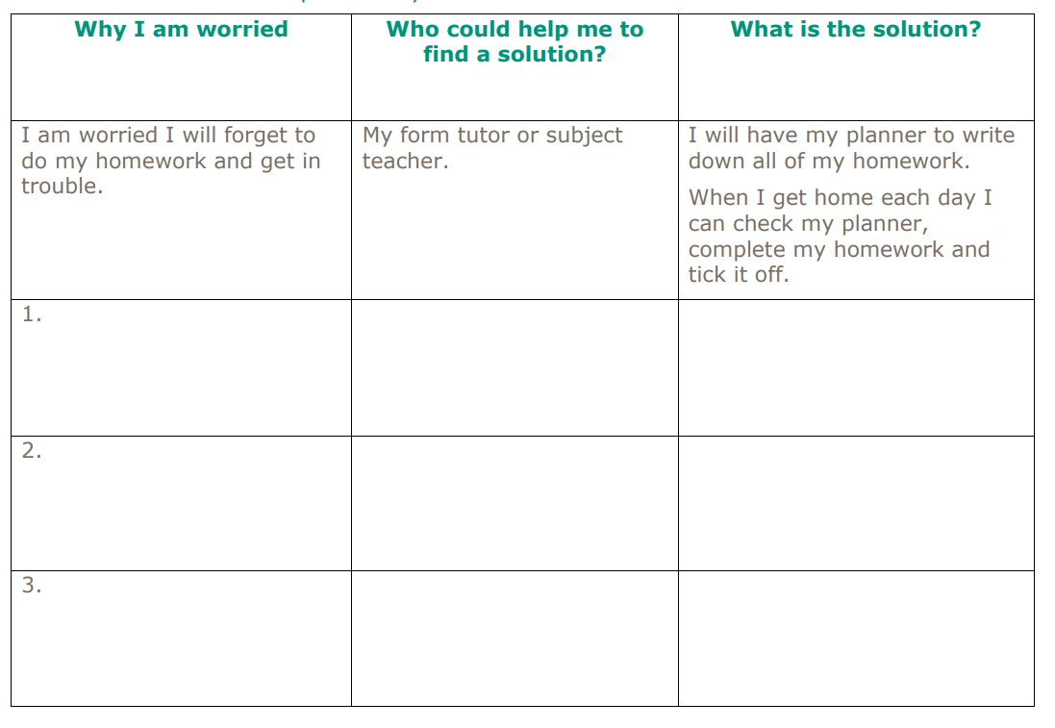
The transition to secondary school
Activity Two: Finding Support
Using your completed table from Activity One: Embracing Change explain three of your potential worries in the table below. - Can you identify who at secondary school you would talk to about this problem? - When you get to your new school, if you are still worried, remember to find this person and ask just like Albie did in the video. - If you have already started secondary school and are worried, find someone at school to talk to just like Albie did in the video. The first one has been completed for you.

Slide 7
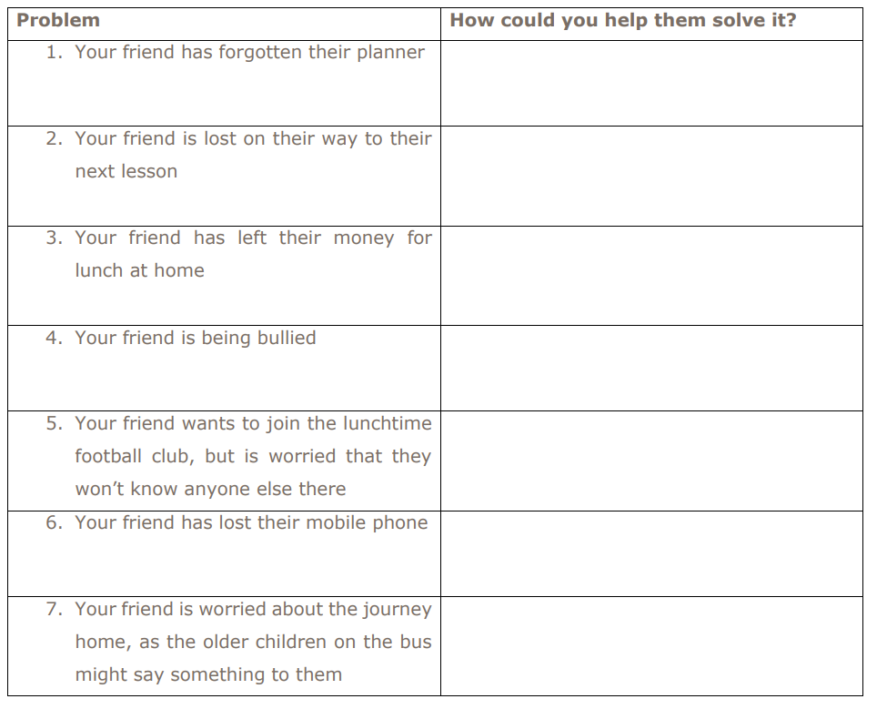
The transition to secondary school
Activity Three: Helping Friends
Below are six problems you or a friend may experience when settling into secondary school. Imagine that a friend has come to you with this problem, how would you help them to solve it?

Slide 8
The transition to secondary school
Organisation at secondary school
At secondary school, we have to be more organised. We need to make sure that we have the books and equipment we need with us and that we complete and hand in our homework on time. We also need to make sure we have good punctuality.
What are your current strengths when it comes to organisation? What do you do already which might help you be organised in year 7?
What are you concerned about when it comes to organisation? What do you need to do differently which might help you be more organised in year 7?
Strategies for being organised
Use your timetable to pack your bags the night before, have somewhere safe at home where you keep your school items so they are easy to find and don’t get lost.
Bring at least one spare pen to ensure you have one to use if you lose yours or it runs out.
Make sure you set your alarm and get up at a time which gives you plenty of time to get ready for school to help ensure you get to school on time. Avoid using phones and technology before we are ready as these can lead to us losing track of time.
Try to use the toilet at break times in order to prevent being late to or having to leave lessons.
Strategies for homework
Try to complete your work on the day it is set and don’t leave it to the last minute. This means that you won’t find you run out of time and if you struggle to complete it you will have lots of time to ask for help from the teacher or your classmates.
Know what homework has been set and when the homework is due, tick it off when it is completed.
Avoid copying and pasting from the internet or using AI as this does not help you to learn the content.

Slide 9
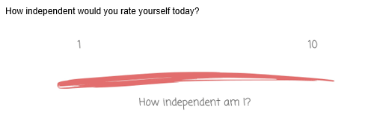
The transition to secondary school
Being Independent
When we join year 7, we are likely to need to be more independent. This means we will have adults telling us what to do less often and will have to be responsible for ourselves and sometimes work out our own solutions to problems.
Think about some of the things you might have to do independently at secondary school e.g. catching a bus, finding my way around, organising my equipment, organising and completing homework, time management, purchasing lunch etc. What do you feel confident doing independently?
Thinking about the same things, what do you feel less confident in doing?

Slide 10
The transition to secondary school
Tips for travelling independently
Make sure you have planned and are confident in the route you will be taking. If you are taking a bus, ensure you know the number and where the bus stop is. If you can, try to practise the journey before your first day as this will make you feel more confident.
If you are not 100% confident, start off doing the journey with someone else, this could be an adult or another pupil.
Have a plan of what to do if there is a problem with your journey, for example if a bus doesn’t arrive. Do you know who you should call or an alternative route?
Give yourself plenty of time to complete your journey, traffic can be particularly bad at the times you are likely to be travelling.
Asking for help
We all need help sometimes, whilst asking for help can sometimes be difficult it can help to reduce the anxiety we might experience when difficult situations happen. It is important to remember that people like to be helpful and adults in school will most likely have dealt with the situation you are facing many times before. If you find approaching an adult difficult, you could take a friend with you or send an email or message.
Asking for help when you don’t understand something in lessons is very important. We should try to be independent and work things out ourselves first but if we can’t find a solution ourselves we need to ask the teacher. If we don’t let the teacher know when we don’t understand you will have gaps in your knowledge which could make learning in the future even more difficult. It is also likely that if you don’t understand that there will be other pupils in the class thinking the same. By asking for help in lessons, you show the teacher that you want to do your best.
Communication
When we are talking to teachers and adults in school, it is important that we talk and listen to them with respect. This could include -
Addressing adults in school as Sir or Miss.
Raising our hands in lessons and waiting to be asked to speak.
Being considerate of the times we are trying to communicate with a teacher, they may not always be available, particularly if you are sending emails or online messages late in the evening or at weekends.
Remembering that all members of our school community are essential for us to operate, this includes staff who may work in the canteen, office or maintaining the school site.

Slide 11
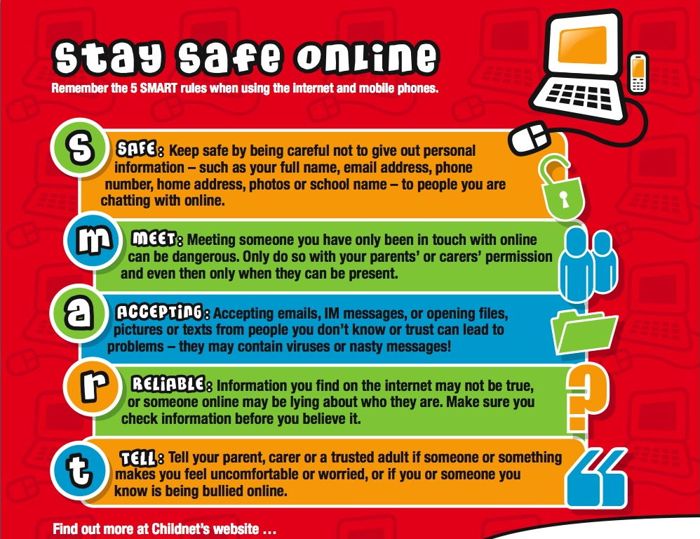
The transition to secondary school
Staying Safe Online
In this school, we are concerned about your safety. This includes your safety in and outside of school as well as your safety online.
What do you currently use your mobile phone for, if you have one? How long do you spend on it?
Are you aware of any dangers which young people might encounter online?

Slide 12

When you go to Secondary School, you will learn a huge number of new skills, and improve skills you have practiced in Primary School. In the goal below, use the list to write in 10 new skills or things you’d like to build on in your years at Secondary School.
Be in a school play or production | Speak another language | Represent your school in a national competition
Learn to play a musical instrument | Volunteer in the local community | Travel to another country
Play for a school team | Learn how to survive in the wild | Take care of the school garden
Learn how to manage money | Taste food from another country | Walk the school dog
Cook a new meal from scratch | Read new books | Take part in a fancy dress day
Create a piece of art | Raise money for charity | Become Head Boy or Girl
Learn how to read a map | Join an after school club | Learn to dance
Use computers to create your own website | Learn First Aid | Improve your singing
Make new friends from other schools | Work as part of a team | Try camping

Slide 13



After secondary school, you can move onto college or an apprenticeship and then to University or into a job! It’s normal not to know what you want to do yet but this is a chance for you to have a think about your dream jobs!
Icons to represent that job:
Icons to represent that job:
Icons to represent that job:

Slide 14
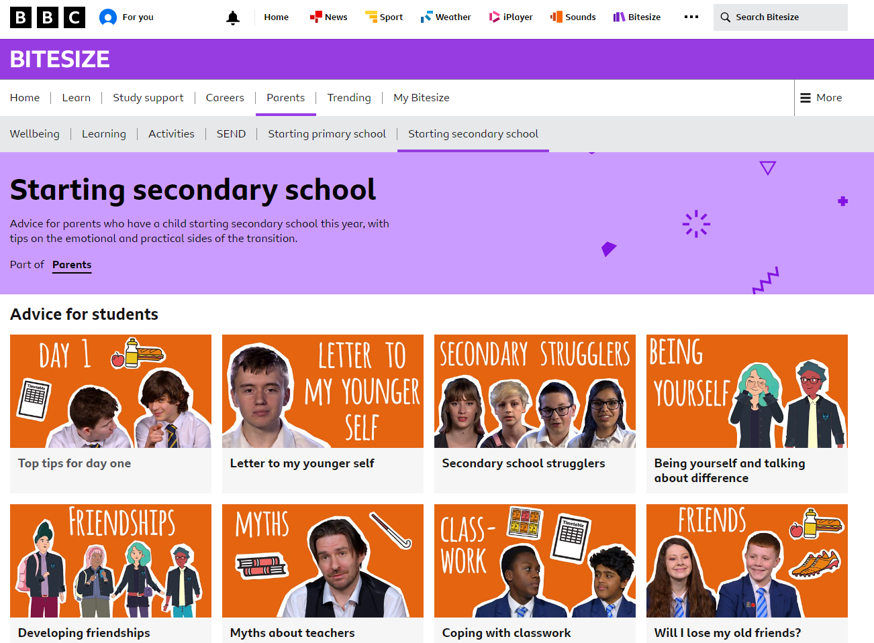
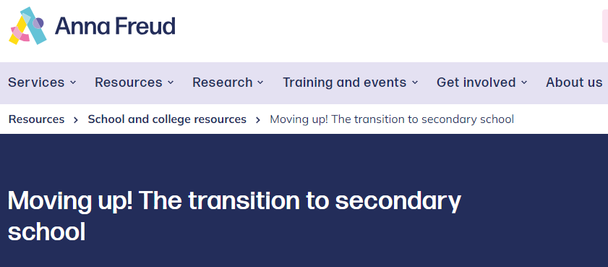
Where to find support with school transition!
Starting secondary school - BBC Parents' Toolkit - BBC Bitesize
www.annafreud.org

